Slide 1
Health Care Re-admission Prediction
Noman Mahmood

Slide 2
Exploratory Data Analysis
Empi - Patient Identifier
Visit-id : Admission ID
Visit_start_date: Admission Date
Visit_End _date : Release date
Visit_amount: Cost
PD (Primary Diagnosis): Disease code - ICD Codes - https://provider.amerigroup.com/docs/gpp/ALL_CARE_CMSHCCRAModel.pdf?v=202111081831
Drg_code: Standardized Hierarchy for cost management –
https://www.aapc.com/codes/drg-codes - range/2/60
Year /Month - Admission Timelines
DOB: Patient Age (Calculate with Year column) - Age in years
Gender - Patient Gender
State- Region in US

Slide 3
Exploratory Data Analysis
Race- Patient category
Elixhauser Comorbidities : Column N - AL - http://mchp-appserv.cpe.umanitoba.ca/viewConcept.php?printer=Y&conceptID=1436#:~:text=The%20Elixhauser%20Comorbidity%20Index%20is,present%20or%20it%20is%20not
Taxonomy_name : Different Categories of Medicines
Enumeration Date: Date of taxonomy
Length_of_stay: duration of admission
drg_los - a score based upon standard score on drg length of stay
ddc_category - Type of admission
Previous Date: Represent how frequent the patient is visiting the hospital , Should not be exceeding more than a year
Admission_interval : Days between two admission , if it is first admission than it takes 365 days
Unplanned_flag: If the admission is planned then we will ignore
CCI Score: https://www.mdcalc.com/charlson-comorbidity-index-cci
Lace Score: risk scores - https://www.ncbi.nlm.nih.gov/pmc/articles/PMC5374974/#:~:text=The%20LACE%20index%20uses%20four,of%206%20months%20before%20admission%20

Slide 4
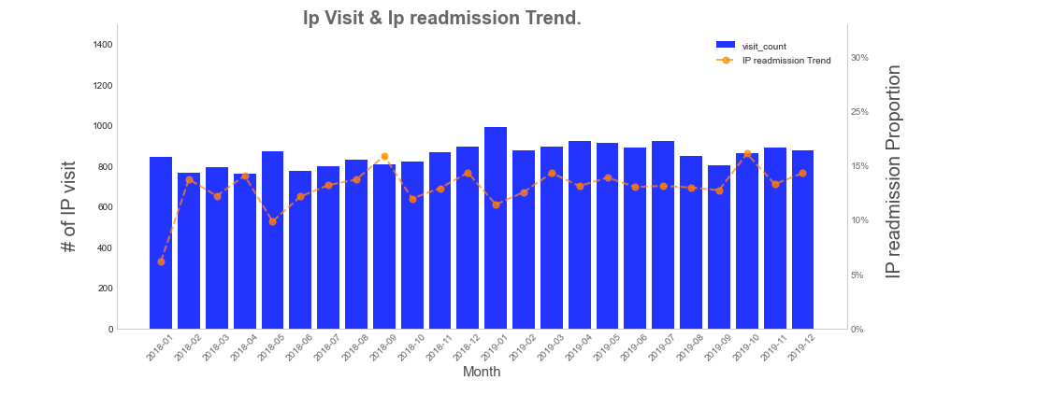
IP Trend Visualization

Slide 5
IP Trend Reflection
Observation
Total span of years is between Jan-18 to Dec- 19
About 850 visits per month are recorded on an averge
Overall average readmission proportion hovers between 13% - 14%
Some cyclic trend is observed but not guaranteed
Max readmission month is repetitive - may be because of year end

Slide 6
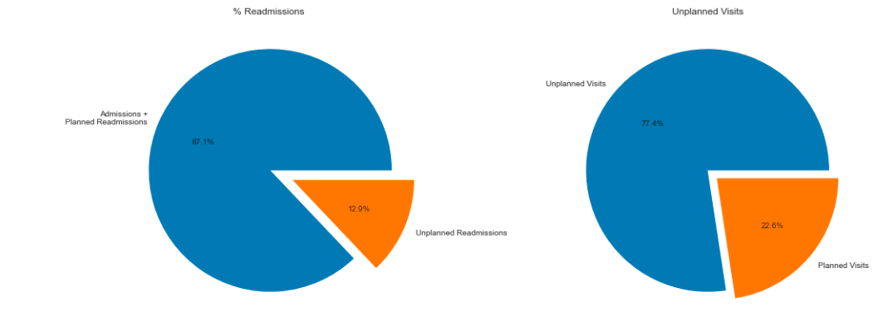
Scheduled Readmission vs Emergency Readmission

Slide 7
Official visit Reflection
Observation
About 13% of the total visits recorded as Unplanned readmission (remaining are either planned readmission or Admission )
77.5% which is 3/4th of the total visit are unplanned in nature

Slide 8
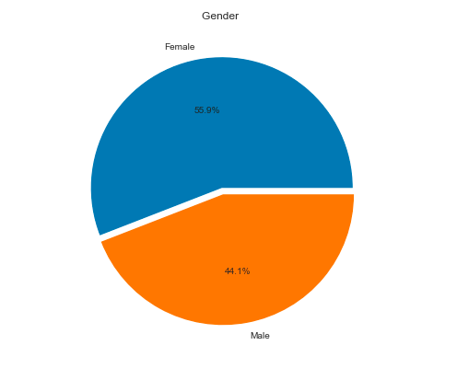
Patient Demographics

Slide 9
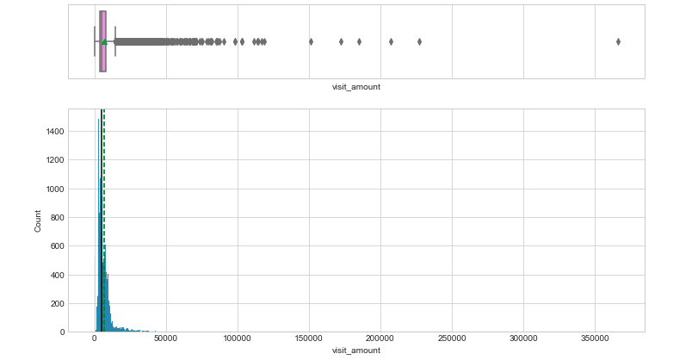
Uni-variant Outlier Analysis – Appointment

Slide 10
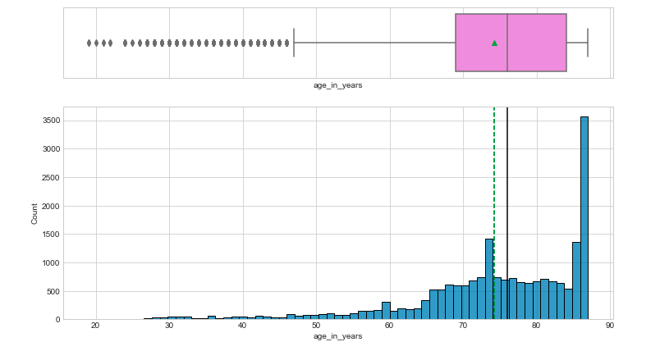
Univariate Outlier Analysis - Age

Slide 11
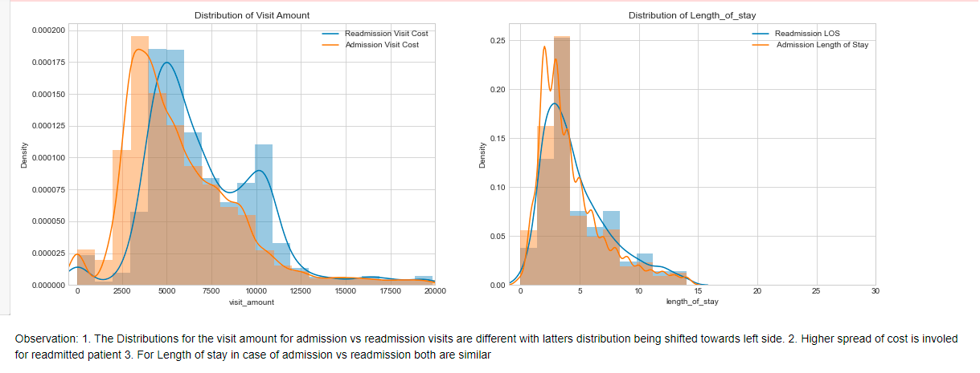
Bi-variant Outlier Analysis – Amount & Length of Stay

Slide 12
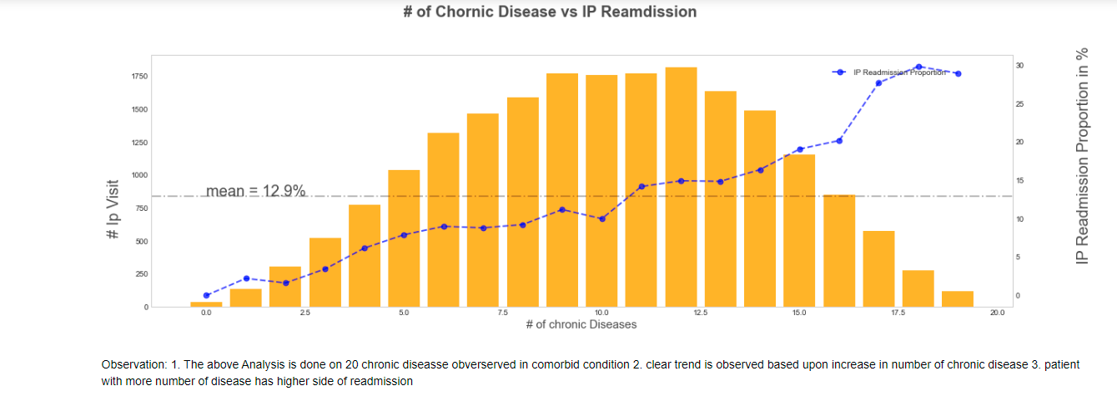
Chronic Disease Based upon inpatient readmission trend

Slide 13
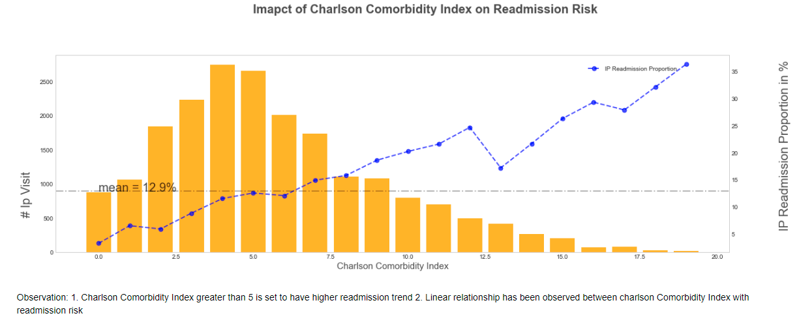
Impact of Carlson Comorbidity index over Readmission Risk

Slide 14
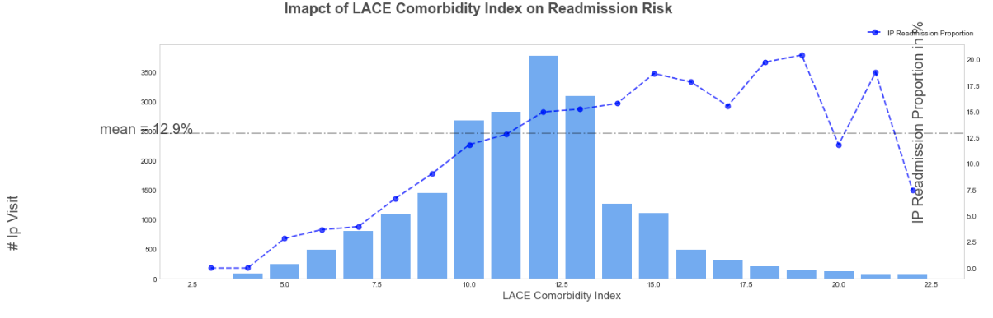
Impact of LACE Score in Readmission Risk

Slide 15
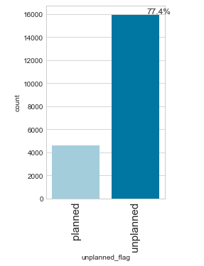
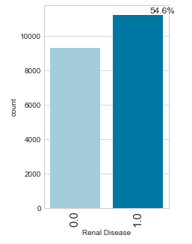
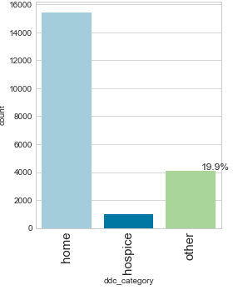
Categorical EDA

Slide 16
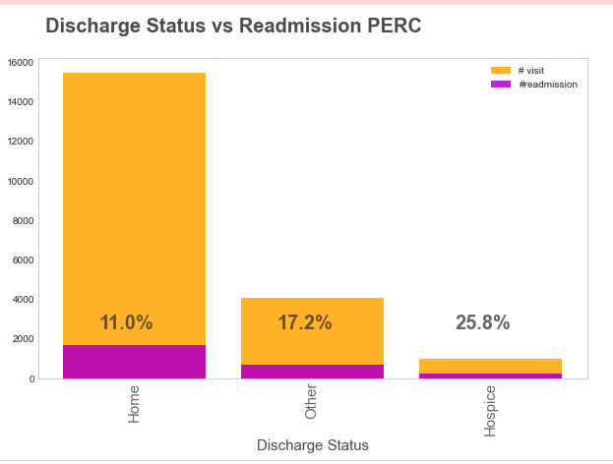
Discharge vs Re-admission

Slide 17
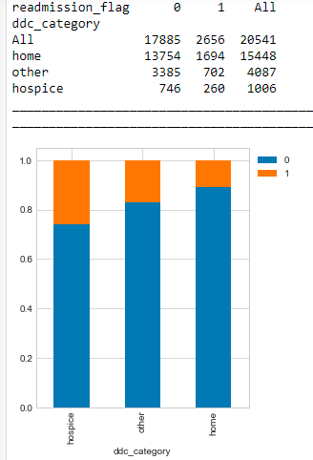
Readmission Analysis

Slide 18
Official visit Reflection
Observation

Slide 19
Slide Title

